Slide 1


HEART GENERAL MEMBERSHIP MEETING
& LUNCHEON
March 10th, 2026

Slide 2

WELCOME

Slide 3

Approval of the Minutes
For HEART’s October General Meeting
Copies are available at each table
-
Janet Zimmerman, Secretary

Slide 4

Treasurer’s Report
Checking Account: $39,450.51
Savings Account: $ 1,684.24
Scholarship: $ 2,192.78
Ellen Hill, Treasurer

Slide 5


FEATURED PRESENTATION:
Our Community at Work:
Services and Opportunities

Slide 6

Tracy Broccolino, President
Community Action Council
of Howard County

Slide 7

Allison Smith, President
AOK Mentoring & Tutoring

Slide 8

Andrew Burkowske, Program Manager
Neighbor Ride

Slide 9
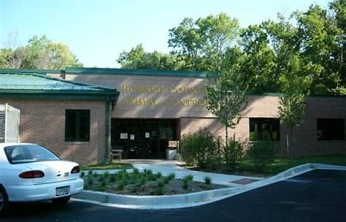
Sheri Fox, Administrator
Howard County Animal Control & Adoption Center

Slide 10


Recruitment & Retention
Welcome new members!
How are we doing?
HEART’s Birthday lottery
… Are you feeling lucky?
Susan Sellner, Chairperson

Slide 11

Necrology Report
Recognizing those who passed in 2025…
Joseph Heaps, 1/6 Barbara Greenfield, 7/30
Judy Snyder, 3/21 Larry Cohen, 12/27
Please let us know if you have information on the passing of a HEART member or colleague
Marlyn Oatts, Chairperson

Slide 12


Socializing with HEART
Join HEART for new shows at Toby’s
Wizard of Oz, April 9
Donna Summer Musical, Oct. 29
White Christmas, Dec. 17
Sue Mascaro, Co-President

Slide 13
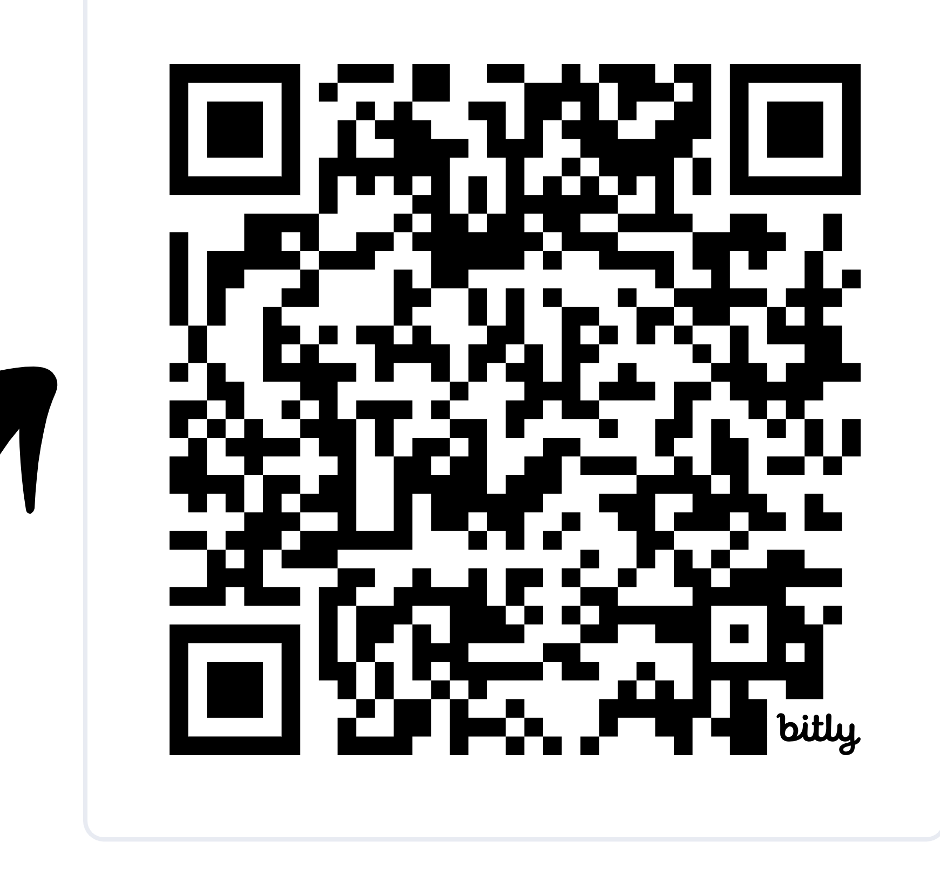
What’s Next?
Next Meeting on May 12th 👍
Nametag Recycling Program 😊
HEART values your input (half-sheets)
⬆️
Join HEART’s Facebook Group!

Slide 14

Thank You for
Joining us Today
from The HEART Executive Team:
Addie, Anne, Corita, Donna, Elise, Ellen, Fran, Gail, Genee,
Gene, Janet, Jim, Karyn, Marlyn, Patti, Ronnie, Sharon, Susan & Sue

